Slide 1
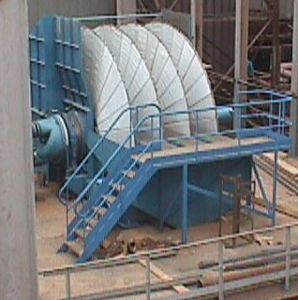
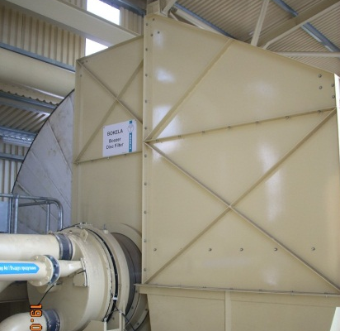
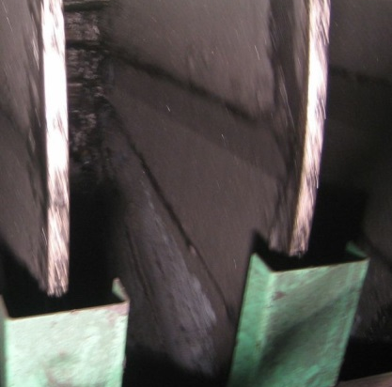
New Developments and Operating Experiences with High Performance Disc Filters
for Tailings Dewatering
André Egger
Paste 2016
www.bokela.com
06/2016

Slide 2
Economical Dewatering of Tailings with High Performance Disc Filters
Main target of tailings dewatering
recovery of water and make tailings fit for next process step, e.g. mxing with cement for mine backfill
Typical properties of tailings
very fine particles → d₅₀ = 1 micron up to 100 micron
sticky filter cakes → difficult to release from filter fabric
low or high pH value → often corrosive properties
solids content → typically 50 - 70 wt% depending on thickener
clay content → hinders filtration and dewatering
Used dewatering equipment
rotary vacuum disc filters
rotary vacuum belt filters
filter presses
Comparison of
CAPEX and OPEX

Slide 3
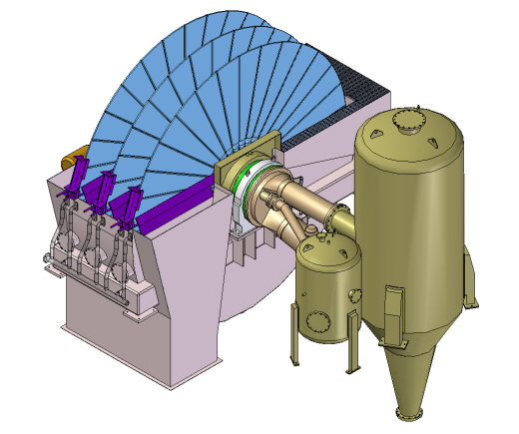
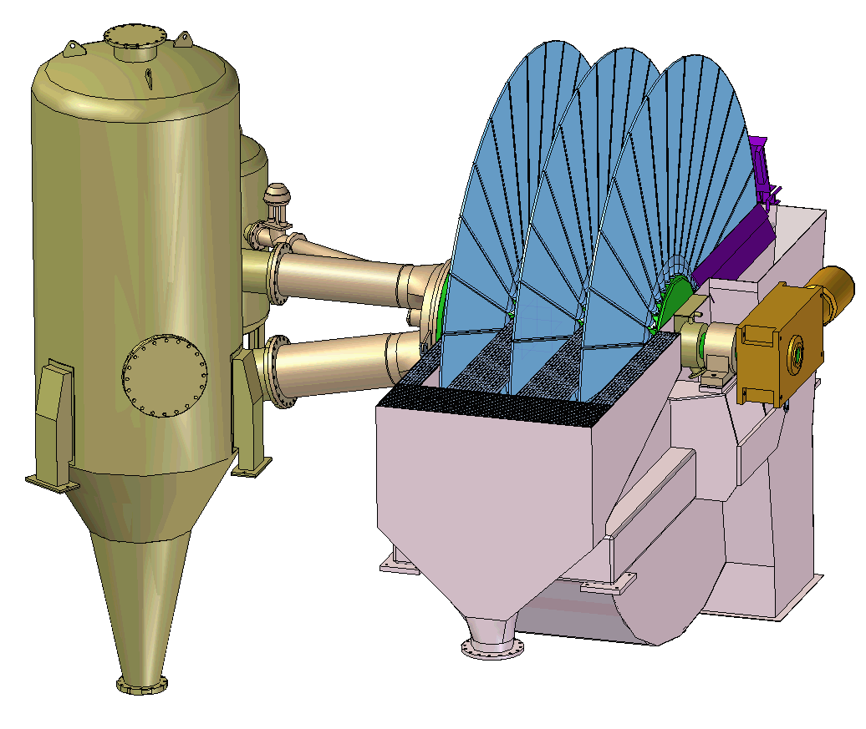
Disc Filter Boozer
Installation
1
Snap blow valve
Filter trough
Drive unit
2
3
5
4
6
Filter segments
Centre barrel
Control head
Filtrate receiver
Blowback tank
8
7
the pipes from control head to receivers avoid bends,
tangential receiver inlet minimizes flow restrictions as far as possible

Slide 4
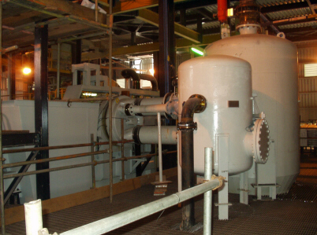
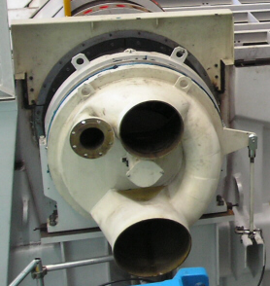
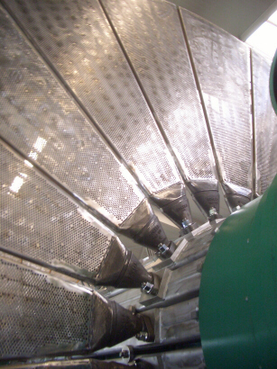
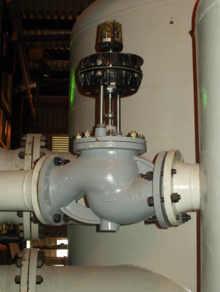
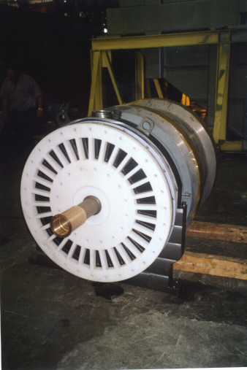
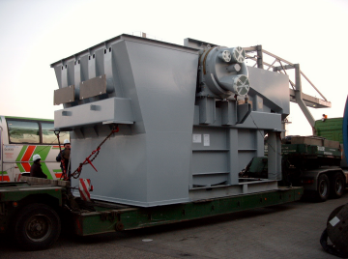
Focus of Modern Disc Filter Design
Control head
Filtrate pipes
Piping to receivers
A
B
C
D
segments
E
Overall pressure loss
p(E) – p(A) = min !
trough
Snap blow valve

Slide 5
Advantages of BOKELA Disc Filters and Conditions for Use
Modern vacuum disc filters are the perfect choice where following conditions and targets apply
e.g. mine backfill is processed – no pond disposal, dry stacking to be evaluated
the tonnage is > 50 t/h and big filter sizes can be applied
moisture of > 18 wt%
energy efficiency is important
space constraint in the filter building – low footprint required
little operator know how required
highest availability for operation (> 97 %)
water consumption for operation of equipment minimised
(average: 1,0 m³/h)

Slide 6
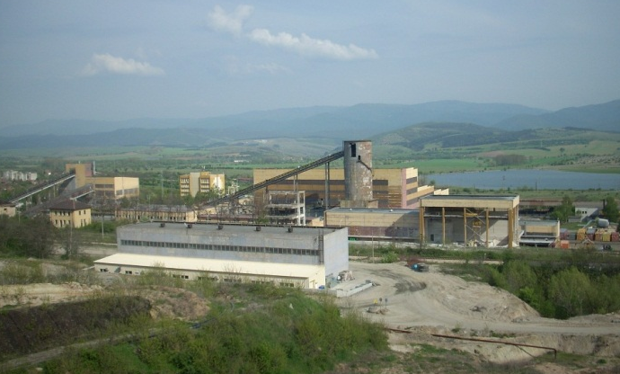
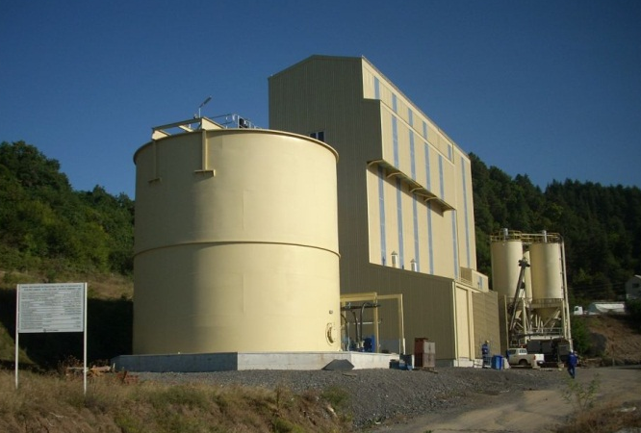
Dewatering of Gold/Copper Tailings in Bulgaria with Disc Filters after Mine Upgrade
Project Data
Mine backfill project in a gold/copper
mine in Europe
Target: reduction of cement added
PSD: d₅₀ = 40 micron
Operational results:
Solids: m_{s} = 110 t/h
feed solids = 50 wt-%
from thickener underflow
Moisture: mc = 19-22 wt-%

Slide 7
Moisture Content of Filtered Tailings for Different Copper/Gold Tailings

Slide 8
Specific Solids Throughput of Different Copper/Gold Tailings versus Filter speed

Slide 9
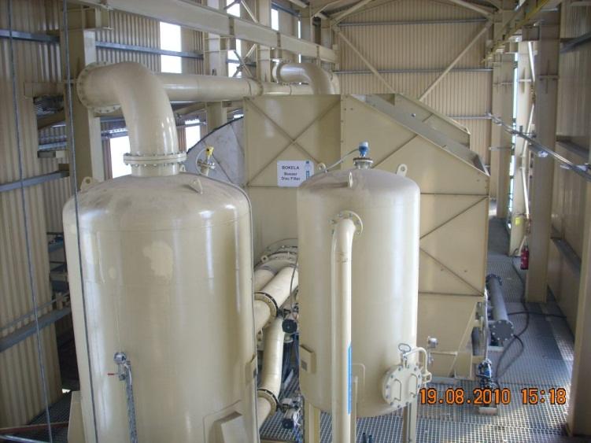
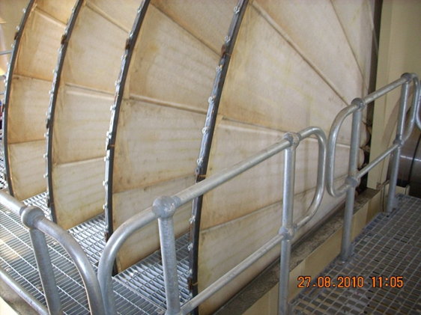
Dewatering of Gold/Copper Tailings in Bulgaria
with Disc Filters after Mine Upgrade
Filter 1 and Filter 2

Slide 10
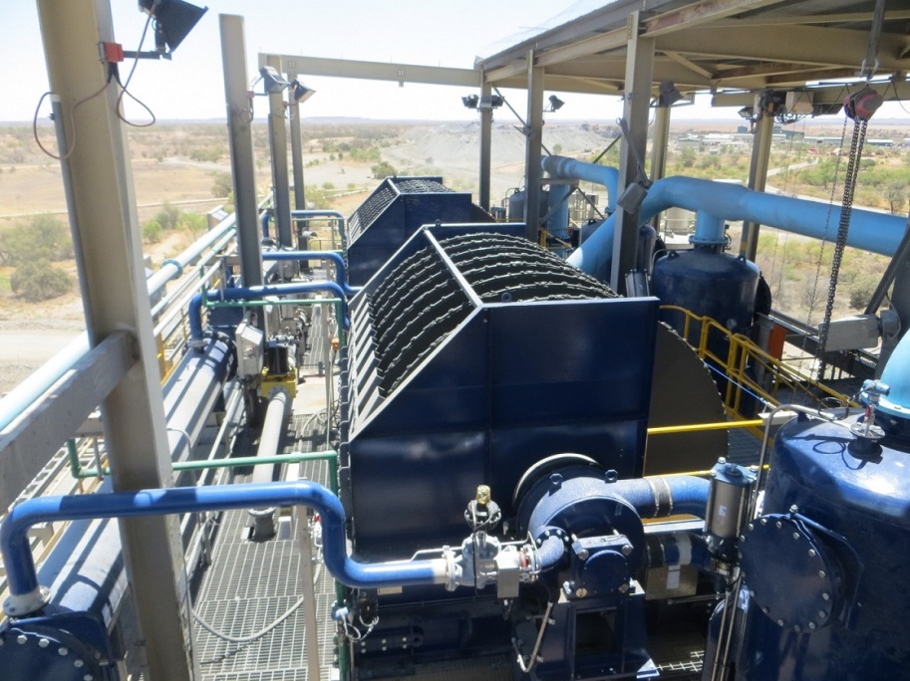
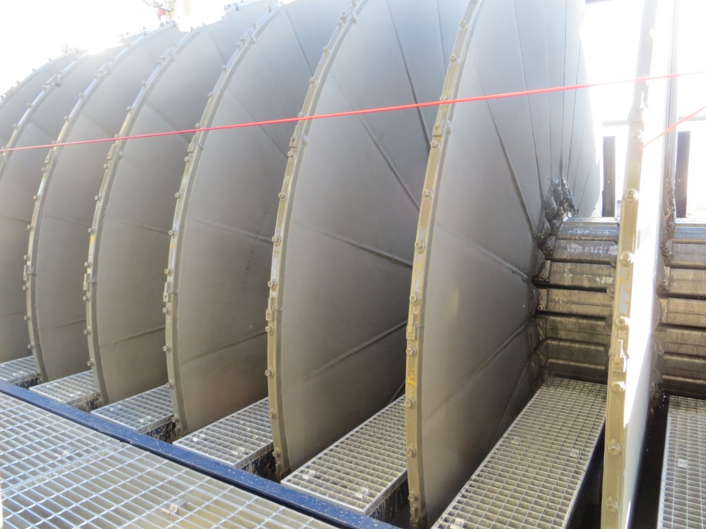
Dewatering of Zinc Tailings with BOKELA Disc Filters
Zinc tailings from a copper and zinc mine in Australia, Qld
Filter: 2 x Boozer ME8 ( 141m² each)
replacing 2 disc filters of old design
Target: plant capacity increase from
240 t/h to 350 t/h tailings
PSD: d₅₀ = 50 micron
Solids: m_{s} = 88 t/h
feed solids = 60 - 65 wt-%
from thickener underflow
Moisture: mc = 20 – 22 wt-% required

Slide 11
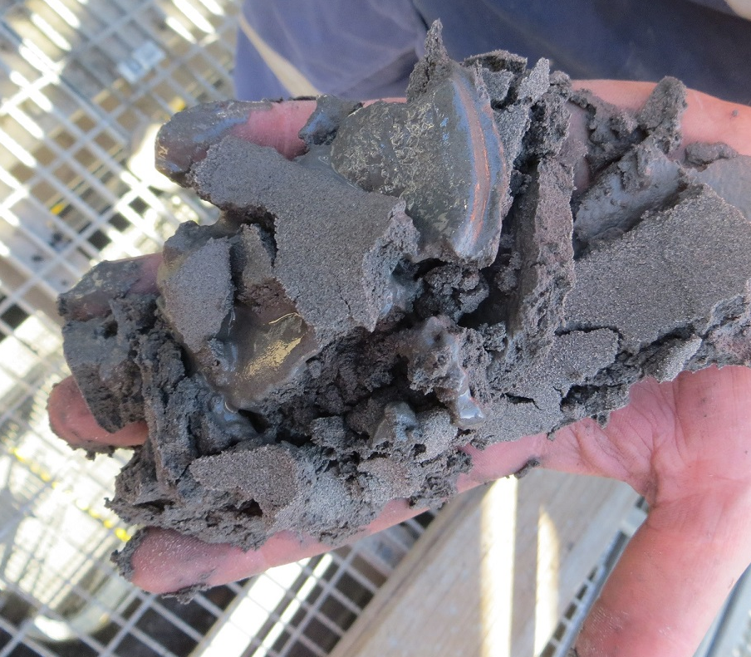
Dewatering of Zinc Tailings with BOKELA Disc Filters
 |  | Predicted value per filter | Operational value per filter
Solids throughput
normal | [t/h] | 175 | > 175
peek (max.) | [t/h] | 200 | 210
Filter speed for normal operation | [rpm] | 1.5 | < 1
Cake moisture | [wt.-%-%] | 20 - 22 | 17 – 20
Flocculent dosage | [g/t DS] | depending on feed charge | 0 - 50 depending on feed

Slide 12
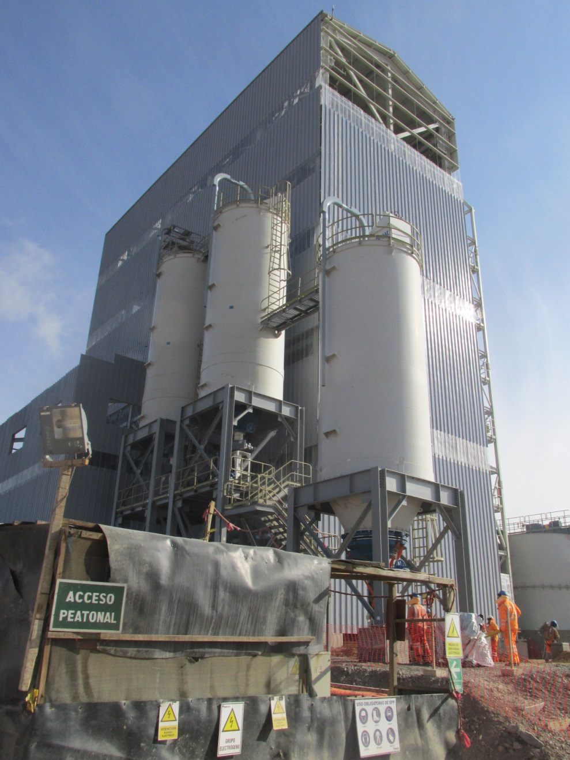
Dewatering of Gold/Silver Tailings with
BOKELA Disc Filters in 4,800 m Above Sea Level
Mine backfill in a
gold/silver mine in Peru
Filter: 2 x Boozer L4 ( 176m² each)
Target:
reduction of water content after thickener to allow for mixing with cement
PSD: d₅₀ = 22 - 27 micron
(high clay content)
Solids: m_{s} = 88 t/h
feed solids = 55 wt-%
from thickener underflow
Moisture: mc = 23 – 24 wt-% required

Slide 13
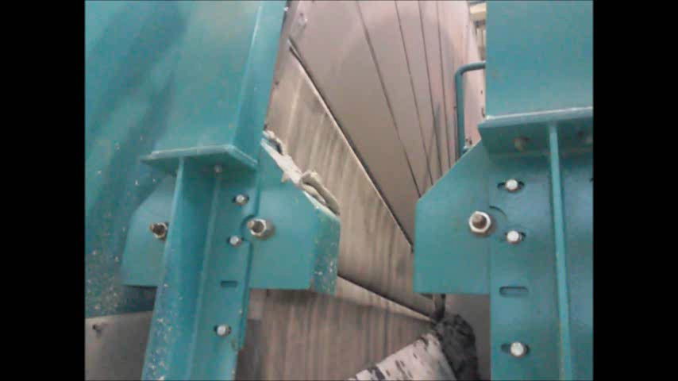
Filter in Operation
Dewatering of Gold/Silver Tailings

Slide 14
Comparison of Investment and Operational Cost of Disc Filter, Belt Filter and Filter Press
Solids: m_{s} = 88 t/h, d₅₀ = 25 - 27 micron
Moisture: mc = 20 – 25 wt-% required
Filter adjustment for efficient use of each equipment:
Filter Data |  | BOKELA Boozer Disc Filter | Horizontal Belt Filter | Filter Press
Cake thickness | [mm] | 8 | 10 | 40
Cake formation angle α₁ | [°] | 150 | 130 | n.a.
Dewatering angle α₂ | [°] | 130 | 150 | n.a.
Filter speed / cycle time | [rpm] / [min] | 0,30 / - | 0.18 / - | - / (25 – 30)
Pressure difference @ vacuum pump | [bar] | 0.45 | 0.45 | 3 feeding / 6 pressing

Slide 15
Filter Data & Operational Results
Filter Data & Operational Results |  | BOKELA Boozer Disc Filter | Horizontal Belt Filter | Filter Press
Filtration area per unit | [m²] | 2 x 176 | 3 x 132 | 4 x 520
Specific solids throughput | [kg/m²h] | >> 250 (up to 330) | 225 | 42
Solids content in feed | [wt-%] | 60 | 60 | 60
flocculents | [g/t] | 30 | 30 | 30
Cake moisture content | [%] | 22 - 23 | 22 - 23 | 19 - 21
Solids throughput per filter | [t/h] | 44 (up to 58) | 30 | 22
Cloth change | [sets/a] | 2 x 12 | 3 x 8 | 4 x 12
Power (filter, hydraulics, compressor, vacuum pump, etc.) | [kwh] | 2 x 110 | 3 x 150 | 4 x 200
Required units for 88 [t/h] | [-] | 2 | 3 | 4

Slide 16
Operation Cost
Operation cost |  | 2 BOKELA Boozer Disc Filter | 3 Horizontal Belt Filters | 4 Filter Presses
Power consumption total | [kW] | 2 x 110 | 3 x 150 | 4 x 200
Specific energy cost | [EUR/kWh] | 0.1 | 0.1 | 0.1
Operation hours | [h/a] | 8000 | 8000 | 8000
Filter cloth exchange | [sets/y] | 2 x 12 | 3 x 8 | 4 x 12
Specific cost for cloth | [EUR/m²] | 30 | 40 | 35
Annual energy cost | [EUR/y] | 176,000 | 360,000 | 640,000
Annual cloth cost | [EUR/y] | 126,700 | 266,100 | 873,600
Flocculent | [EUR/y] | 80,000 | 80,000 | 80,000
Maintenance & spares | [EUR/y] | 36,000 | 45,000 | 160,000
Total operation cost / year | [EUR/y] | 418,700 | 751,100 | 1.753,600
Specific operation cost | [EUR/t] | 0.59 | 1.06 | 2,49

Slide 17
Invest Cost
Invest cost |  | BOKELA Boozer Disc Filter | Horizontal Belt Filter | Filter Press
Filter cost with receivers and drives | [EUR] | 2 x 750,000 | 3 x 900,000 | 4 x 1,200,000
Auxiliary units with necessary vacuum pumps, compressor, hydraulics etc. | [EUR] | 2 x 200,000 | 3 x 250,000 | 4 x 300,000
Building cost with piping and electrical installation per unit | [EUR] | 2 x 2,375,000 | 3 x 2,875,000 | 4 x 2,500,000
 |  | For all units:
Total invest cost | [EUR] | 6,650,000 | 12,075,000 | 16,000,000

Slide 18
Conclusions
You look for the optimum solution for your tailing treatment
with lowest invest cost?
with lowest operational cost?
Check your conditions!
BOKELA Vacuum Disc filters can be used where following conditions apply
the tonnage is > 50 t/h and big filter sizes can be applied
mine backfill is processed
and/or
moistures of > 18 wt% for the downstream tailing treatment/ storage

Slide 19
Many thanks for your interest
www.bokela.com

